Slide 1

A PROJECT PRESENTATION BY:
NAVEEN SADINENI
AKHIL KRISHNA HANUMANTHU
MADHUSUDHAN REDDY NAREDDY
LECTURER: YASH SHETH

Slide 2

PATH TO YOGA LIFE

Slide 3
PROBLEM SPACE :
In this technological world every person is dealing with stress and other mental illness . So, it is necessary to free from those tensions. The best way to revive from stress is doing yoga and meditation.
Lack of awareness about yoga
Time management

Slide 4
SOLUTION:
We provide a way to get familiar with yoga .
We provide home tutors .
Our website yoga guru helps them to schedule their classes based on their availability .
Our website gives more information on yoga .

Slide 5
FEATURES:
TIME EFFICIENT
PLETHORA OF INFORMATION
FLEXIBLE

Slide 6
ARCHITECTURAL DESIGN:
Home
Home page
Classes
schedule
Contact
Information about website
Different yoga classes
Booking appointment
Availability of classes
Contact information

Slide 7
FUNCTIONAL AND NON-FUNCTIONAL REQUIREMENTS:
Functional requirements:
Login page.
Basic videos of types of yoga.
Information about tutor.
Non-functional requirements:
Efficiency.
Security.
Manageability.

Slide 8
LANGUAGES :
HYPER TEXT MARKUP LANGUAGE(HTML) .
CASCADING STYLE SHEET(CSS) .
PHP
DATABASE:
XAMPP SERVER

Slide 9
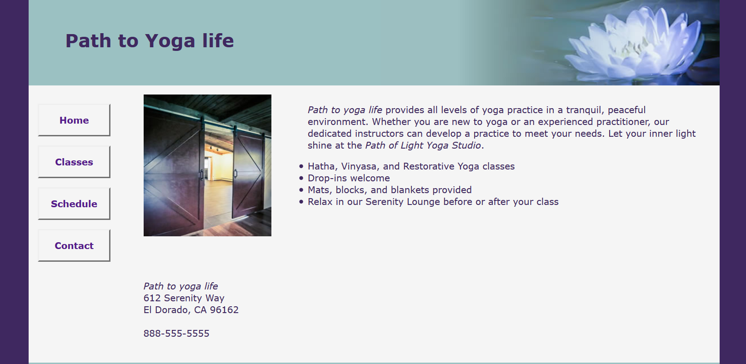
GRAPHICAL USER INTERFACE DESIGN:

Slide 10
FUTURE ENHANCEMENTS:
LIVE CHAT.
PRIME MEMBERSHIP.
YOGA VIDEOS.
ONLINE TUTORIAL.
MOBILE APPLICATION.

Slide 11
THANK YOU

